Slide 1
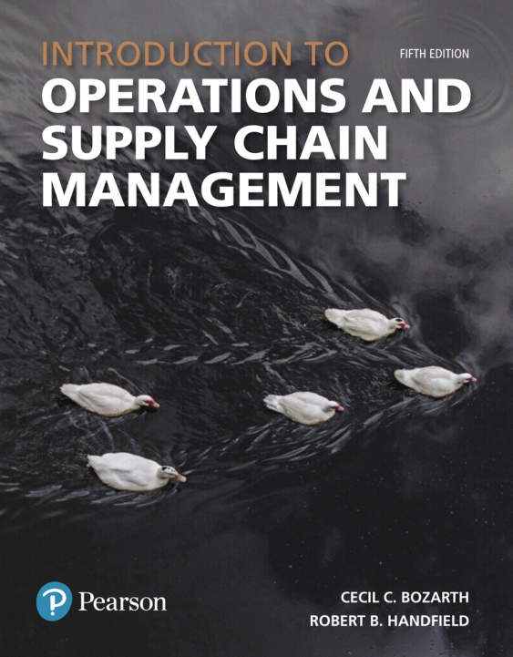
Introduction to Operations and Supply Chain Management
Fifth Edition
Chapter 9
Forecasting
Copyright © 2019, 2016, 2014 Pearson Education, Inc. All Rights Reserved.

Slide 2
Introduction
9.1- Forecast types
9.2- Laws of Forecasting
9.3- Selecting a Forecasting method
9.4- Qualitative Forecasting methods
9.5- Time Series Forecasting models
9.6- Casual Forecasting models

Slide 3
Introduction
Forecast – An estimate of the future level of some variable.
Forecasting is used to determine:
  Long-term capacity needs
  Yearly business plans
  Shorter-term operations and supply chain activities

Slide 4
Forecast Types
Demand
  Overall market demand
  Firm-Level demand
Supply
  # of current producers and suppliers
  Projected aggregate supply levels
  Technological and political trends
Price
  Forecast prices for key materials and services

Slide 5
Laws of Forecasting
Law 1: Forecasts Are Almost Always Wrong (But They Are Still Useful).
Law 2: Forecasts for the Near Term Tend To Be More Accurate.
Law 3: Forecasts for Groups of Products or Services Tend to Be More Accurate.
Law 4: Forecasts Are No Substitute For Calculated Values.

Slide 6
Selecting a Forecasting Method
Qualitative forecasting techniques – Forecasting techniques based on intuition or informed opinion.
  Used when data are scarce, not available, or irrelevant.
  What we think? An educated guess based on a trend?
Quantitative forecasting models – Forecasting models that use measurable or historical data to generate forecasts.
  Time series and causal models

Slide 7
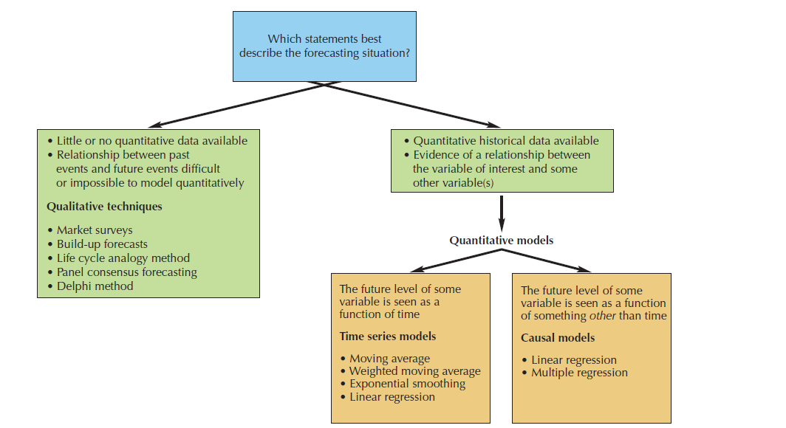
Selecting a Forecasting Method
Figure 9.2

Slide 8
Qualitative Forecasting Methods
Market surveys- Example, will consumers like X? New product?
Panel consensus forecasting- Brings experts together
Delphi method-Experts work individually, then share with group. Results are then refined, this is repeated until consensus is reached.
Life-cycle analogy method- Seeks to identify time frames and demand levels: introduction, growth, maturity, and decline stages of a new product or service.
Build-up forecasts- market segment experts estimate demand, then add up results to gain an overall forecast.

Slide 9
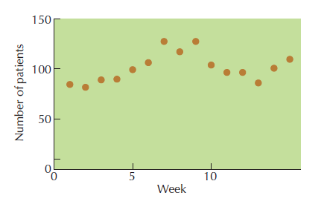
Time Series Forecasting Methods
Time series forecasting models – A quantitative forecasting model that uses a time series to develop forecasts.
  Time series – A series of observations arranged in chronological order
Figure 9.3

Slide 10
Time Series Forecasting Methods
Demand Patterns
  Randomness – Unpredictable movement from one time period to the next.
  Trend – Long-term movement up or down in a time series. FSC example.
  Seasonality – A repeated pattern of spikes or drops in a time series associated with certain times of the year. CNY, holiday time, specific consumer needs.

Slide 11
Time Series Forecasting Methods
Last Period Model - The simplest time series model which uses demand for the current period as a forecast for the next period.
F_{t+1} ⁼ D_{t}
where F_{t+1}⁼ forecast for the next period, t+1
and D_{t} ⁼ demand for the current period, t

Slide 12
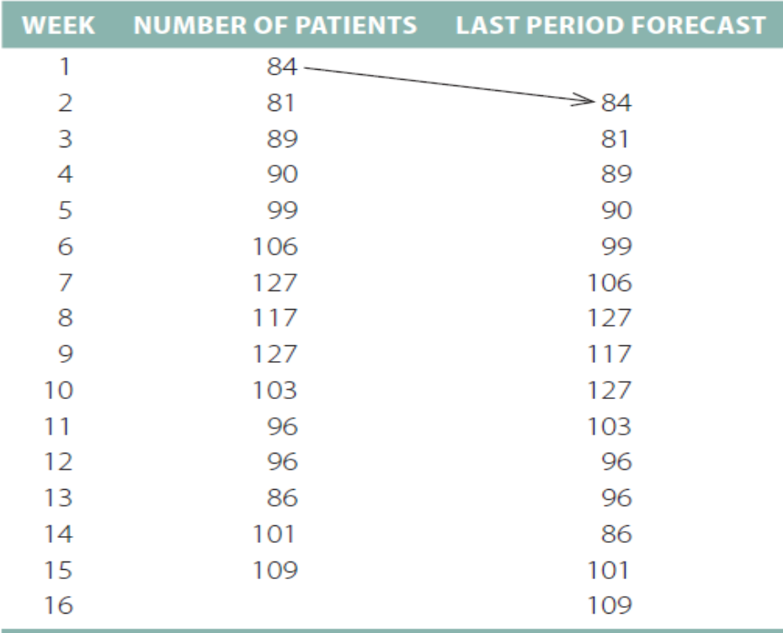
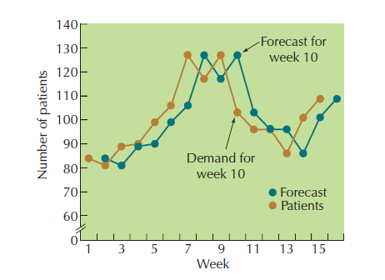
Time Series Forecasting Methods
Last Period
Table 9.3
Figure 9.5

Slide 13
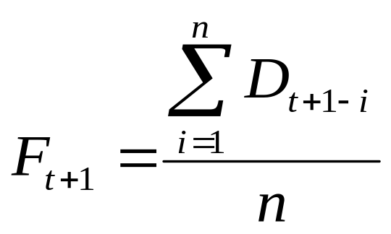
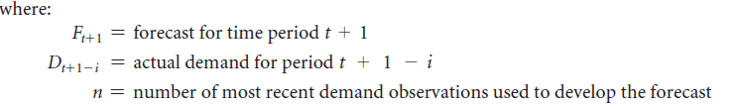
Time Series Forecasting Methods
Moving Average Model – A time series forecasting model that derives a forecast by taking an average of recent demand values.

Slide 14
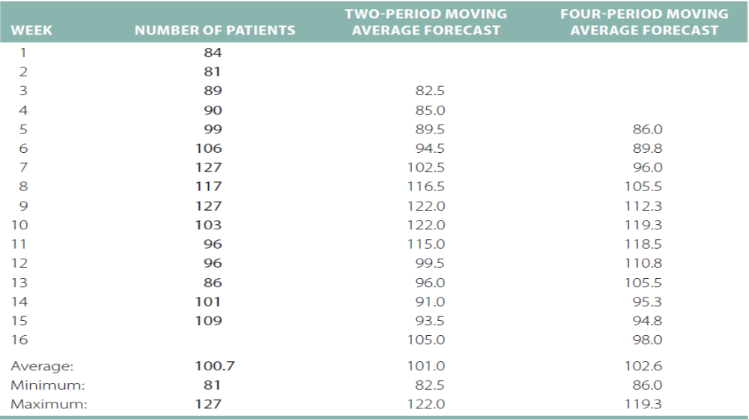
Time Series Forecasting Methods
Two-Period and Four-Period Moving Average Forecasts
Example: Week 16 = (101 + 109)/2 = 105
Table 9.4

Slide 15
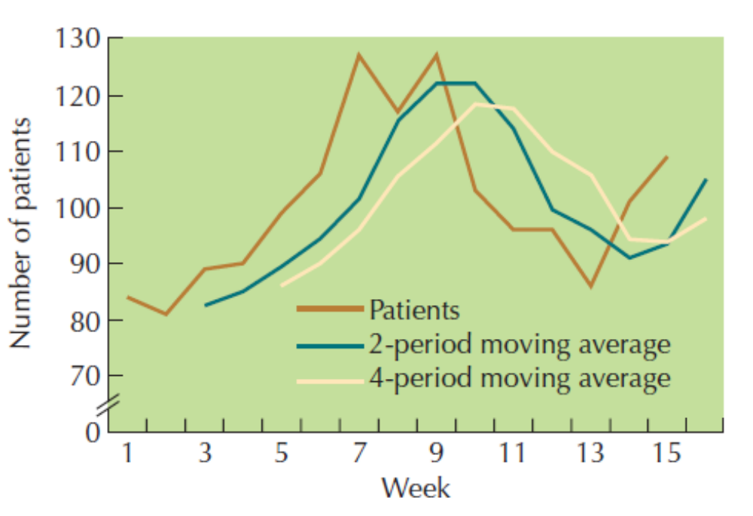
Time Series Forecasting Methods
Two-Period and Four-Period Moving Average Forecasts
Figure 9.6

Slide 16

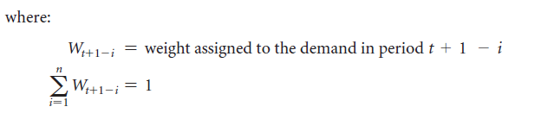
Time Series Forecasting Methods
Weighted Moving Average Model – A form of the moving average model that allows the actual weights applied to past observations to differ.

Slide 17
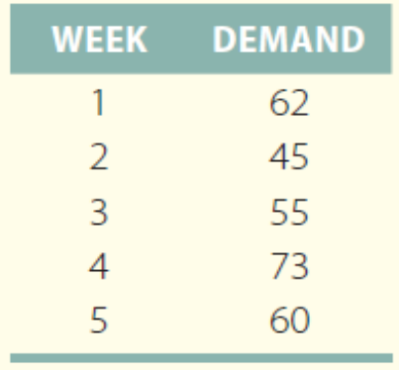
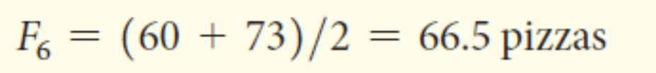
Example 9.1 – Flavio’s Pizza
Flavio’s Pizza has recorded the following demand history for each Friday night for the past five weeks.
Develop forecasts for week 6 using a two-period moving average and a 3-period weighted moving average using the following demands and weights (0.4, 0.35, and 0.25, starting with the most recent observation.
The two-period moving average forecast would be:
=Demand/number of most recent demand observations.
The three-period weighted moving average forecast would be:
=weight*demand time + weight *demand time + weight* demand time…=X

Slide 18

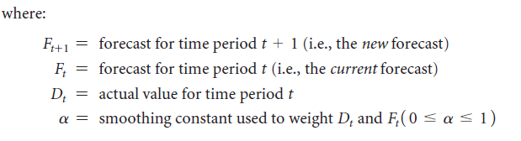
Time Series Forecasting Methods
Exponential Smoothing Model – A form of the moving average model in which the forecast for the next period is calculated as the weighted average of the current period’s actual value and forecast.
Smoothing value* actual demand value + (1- α)∗ Forecast for period 1

Slide 19
Time Series Forecasting Methods
Exponential Smoothing Model
  The general rule for determining the α value (Alpha):
    The greater the randomness in the time series data, the lower the α value should be.
    The less randomness in the time series data, the higher the α value should be.

Slide 20
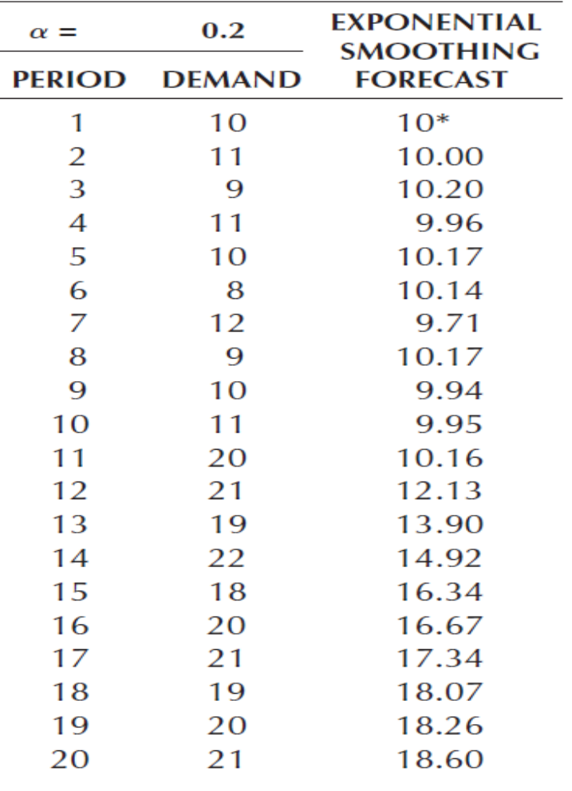
Example 9.2 – Exponential Smoothing
Using the following time series data, calculate an exponential smoothing forecast for periods 2 through 7 using a smoothing constant value of 0.8
Figure 9.8

Slide 21
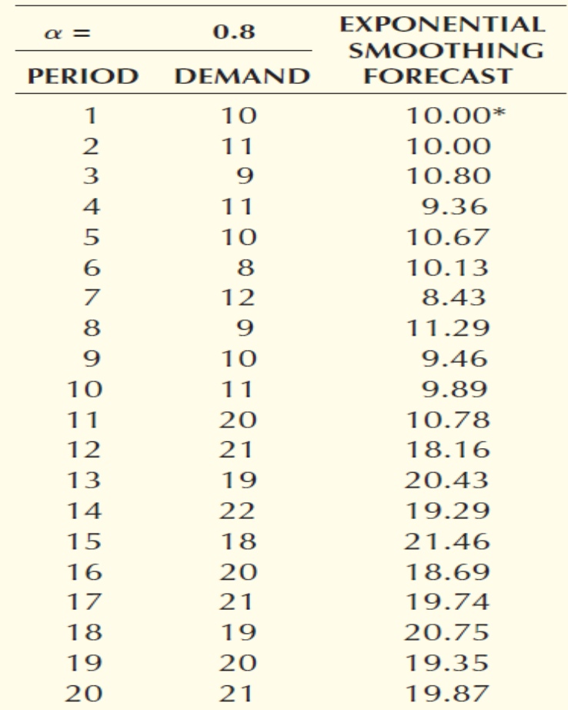
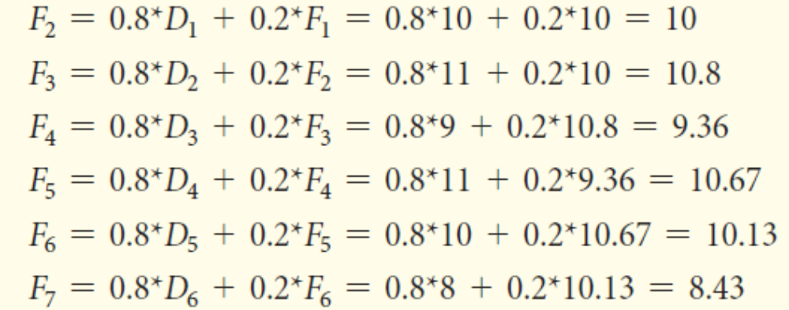
Example 9.2 – Exponential Smoothing
Using the following time series data, calculate an exponential smoothing forecast for periods 2 through 7 using a smoothing constant value of 0.8
Smoothing value* actual demand value + (1- α)∗ Forecast for period 1
The detailed calculations for F₂ through F₇ are:
Figure 9.9

Slide 22
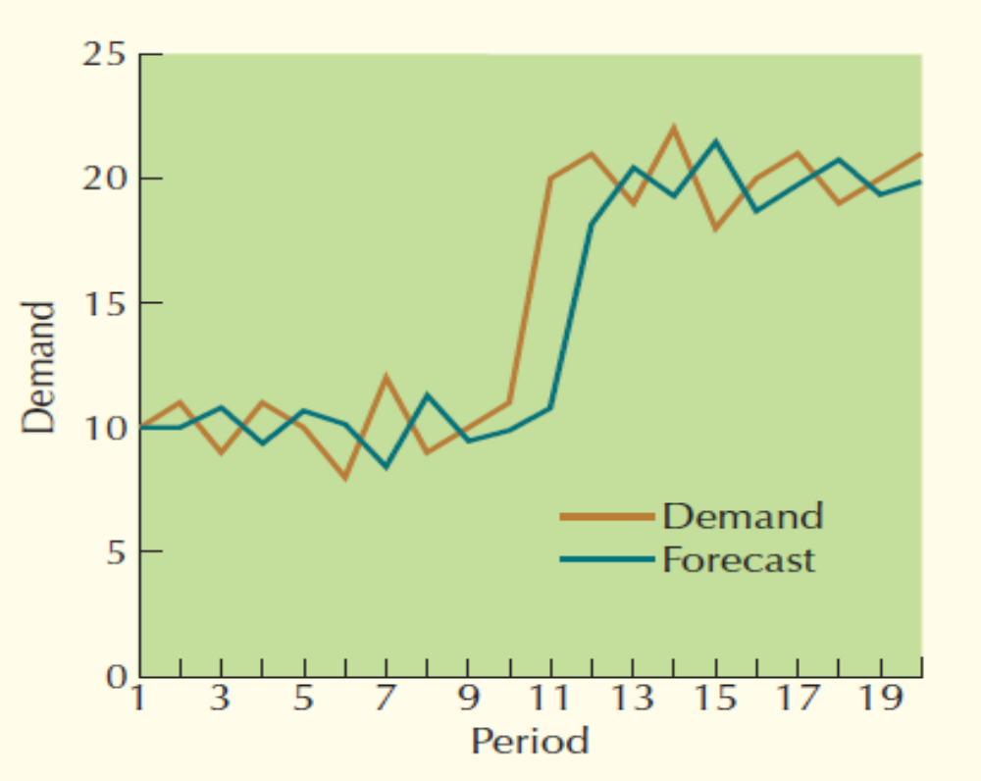
Example 9.2 – Exponential Smoothing
Exponential Smoothing Forecast (α = 0.8)
Figure 9.9

Slide 23
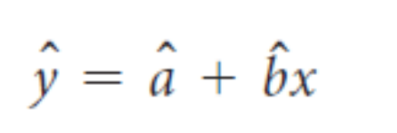
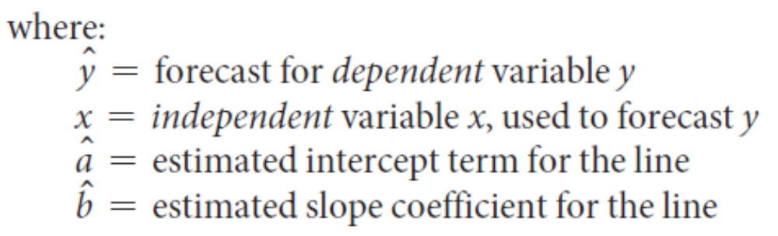
Time Series Forecasting Models
Linear Regression – A statistical techniques that expresses a forecast variable as a linear function of some independent variable.
  Can be used to develop time series and causal forecasting models.

Slide 24
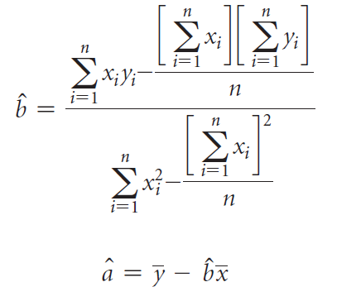
Time Series Forecasting Models
Linear Regression Calculations,
for the y intercept (a) and slope (b)
SUM XY-Sum X*Sum Y / N
/
SUM X^2-X^2/N

Slide 25
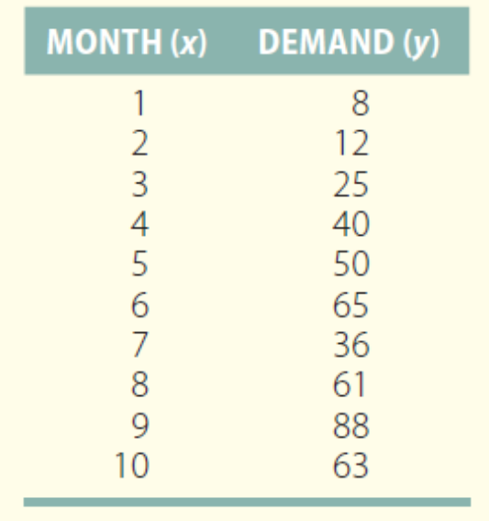
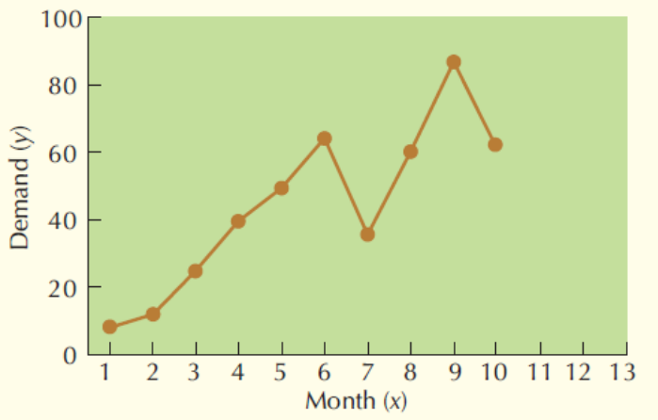
Example 9.3 – Clem’s Competition Clutches
Mike Clem, owner of Clem’s
Competition Clutches, designs
and manufacturers heavy-duty car
clutches for use in drag racing.
In his first 10 months of business,
Mike has experienced the demand
shown in Table 9.7 and Figure 9.11.
Use Linear Regression to forecast
demand for months 11, 12, and 13.
Ten-Month Time Series of Demand
Table 9.7

Slide 26
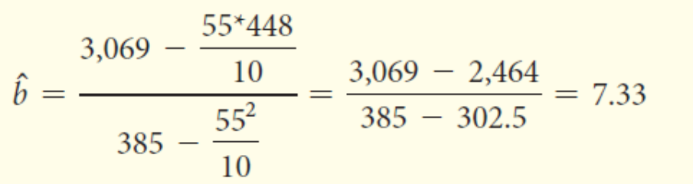
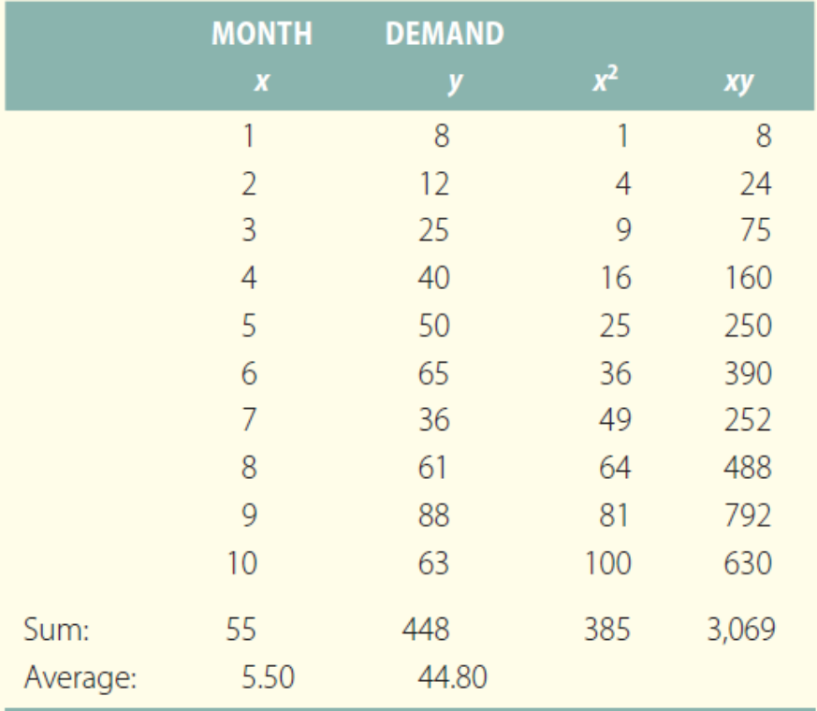


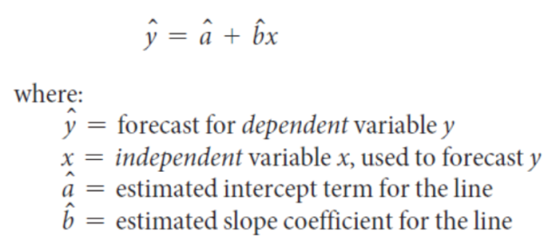
Example 9.3 – Clem’s Competition Clutches
SUM XY-Sum X*Sum Y / N
/
SUM X^2-X^2/N
Average of Y-b*Average of X

Slide 27
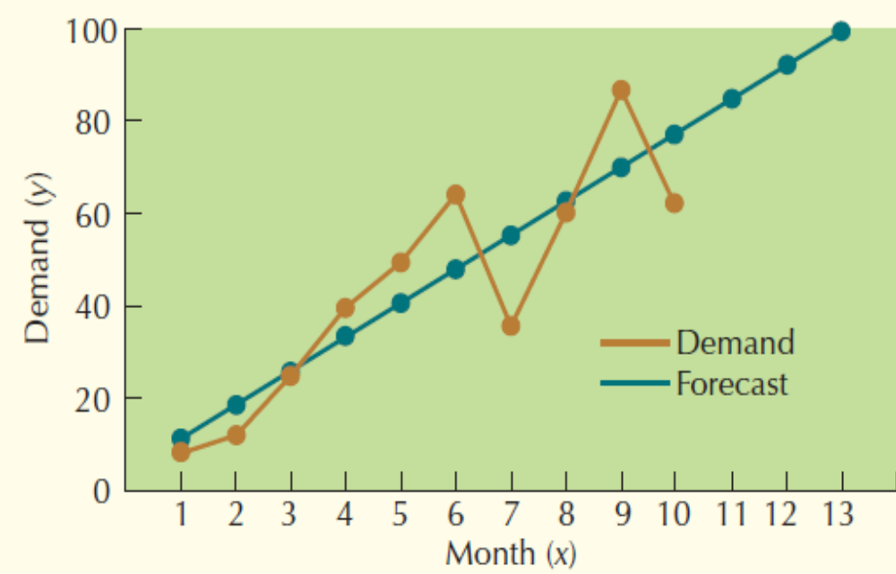
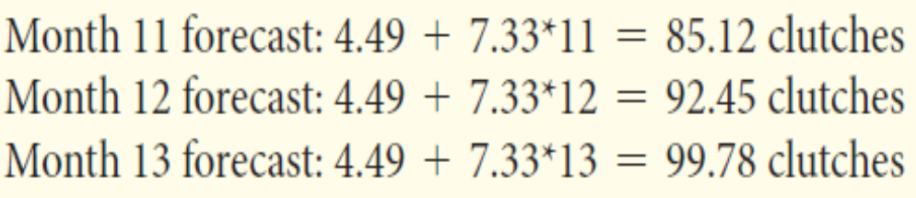
Example 9.3 – Clem’s Competition Clutches
Linear Regression to forecast!!
Figure 9.12

Slide 28
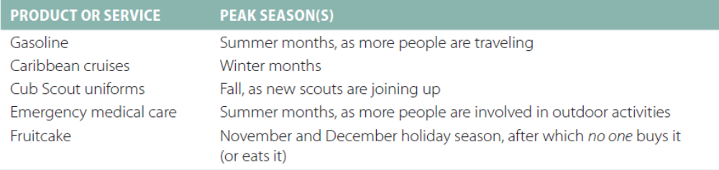
Time Series Forecasting Models
Seasonality – Repeated patterns or drops in a time series associated with certain times of the year.
Examples of Products and Service That Experience Seasonality
Table 9.8

Slide 29
Time Series Forecasting Models
Seasonal Adjustments Four-Step Procedure:
  For each of the demand values in the time series, calculate the corresponding forecast using the unadjusted forecast model.
  For each demand value, calculate (Demand/Forecast). If the ratio is less than 1, then the forecast model overforecasted; if it is greater than 1, then the model underforecasted.
  If the time series covers multiple years, take the average (Demand/Forecast) for corresponding months or quarters to derive the seasonal index.
  Multiply the unadjusted forecast by the seasonal index to get the seasonally adjusted forecast value.

Slide 30
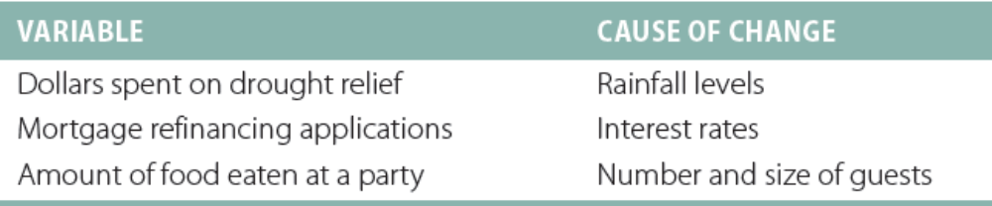
Causal Forecasting Models
Causal Forecasting Models – A class of quantitative forecasting models in which the forecast is modeled as a function of something other than time.
  Linear Regression
  Multiple Regression

Slide 31

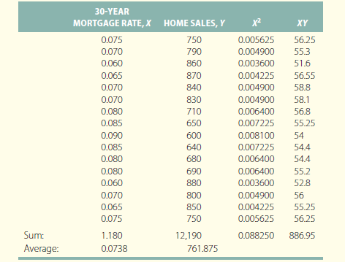
Causal Forecasting Models
SUM XY-Sum X*Sum Y / N
/
SUM X^2-X^2/N
Linear Regression
Forecasted home sales =
1,488.58 – 9,846.94(mortgage rate)
Forecasted home sales at 6% mortgage rate:
1,488.58 – 9,846.94(6%) = 898 home sales
Forecasted home sales at 8% mortgage rate:
1,488.58 – 9,846.94(8%) = 701 home sales

Slide 33
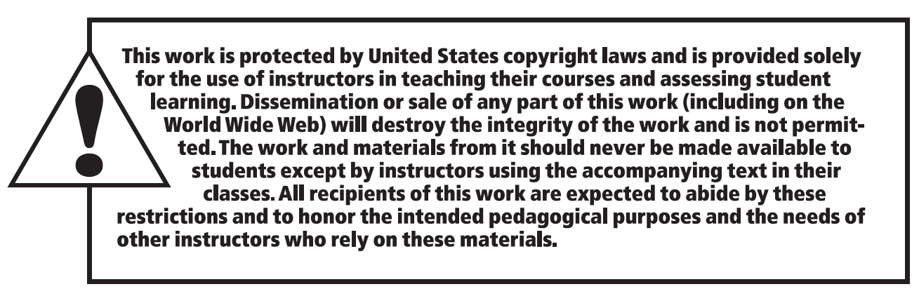
Copyright

